Slide 1


FOOD DONATION AND REDISTRIBUTION
SYSTEM

Slide 2

OUR TEAM
MOHAMMED YOUSEF MOHAMMED ABDULKAREM - 1221305727
MOHAMMED AAMENA MOHAMMED Abdulkarem - 1221305728
AMIRAH AISYAH BINTI AZMAN - 1221305806
FARAH HANIM BINTI MOHD ZAMRI - 1221305625

Slide 3

The Problem & SDG Alignment
PROBLEM STATEMENT
17,000 tonnes of food are wasted daily in Malaysia (Source: SWCorp, 2024)
Over 3.8 million Malaysians face food insecurity (Source: UNICEF, 2023)
ALIGNED SUSTAINABLE Development Goals (SDGs)
SDG 11 – Sustainable Cities and Communities
SDG 12 – Responsible Consumption and Production
Our System’s Purpose
THIS PLATFORM DIRECTLY ADDRESSES THESE CHALLENGES BY STREAMLINING FOOD REDISTRIBUTION, REDUCING WASTE, AND INCREASING FOOD ACCESSIBILITY FOR UNDERSERVED COMMUNITIES IN MALAYSIA.

Slide 4
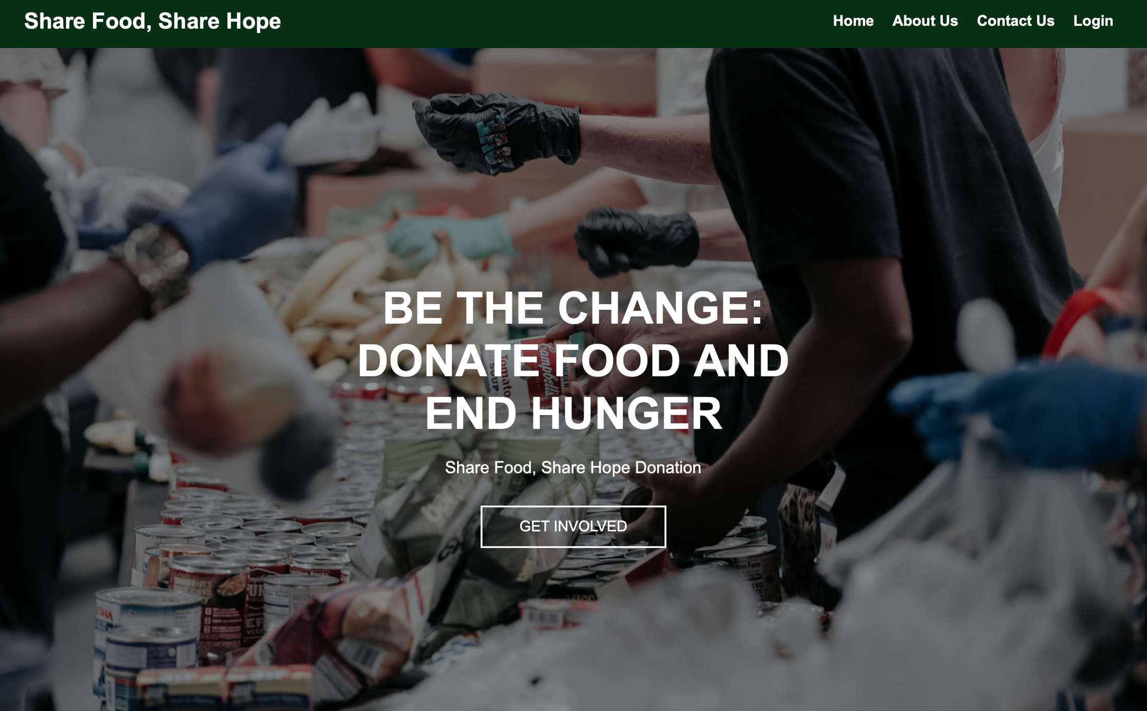
System Objectives and Deliverables
Objectives
Develop a scalable, web-based food redistribution platform
Ensure efficient, traceable, and secure food donation from donors to recipients
Implement role-based access (Donor, Recipient, Admin) and real-time features
Deliverables
Functional prototype (90% completion)
UML diagrams (Class, ERD, Use Case)
Design pattern documentation (Factory, Strategy, Observer, Singleton, Decorator)

Slide 5
Scope
In-Scope
Out-of-Scope
Mobile application for donors/recipients
Third-party logistics and delivery APIs
Blockchain-based audit trails for donation transparency
Donor: List, edit, delete food items; schedule pickups
Recipient: Browse, request food; track status
Admin: Manage users/listings; generate reports
Design Patterns:
Factory (User roles)
Observer (Real-time updates)
Strategy (Matching algorithm)
Decorator (Notifications)
Singleton (Central config/reporting)

Slide 6
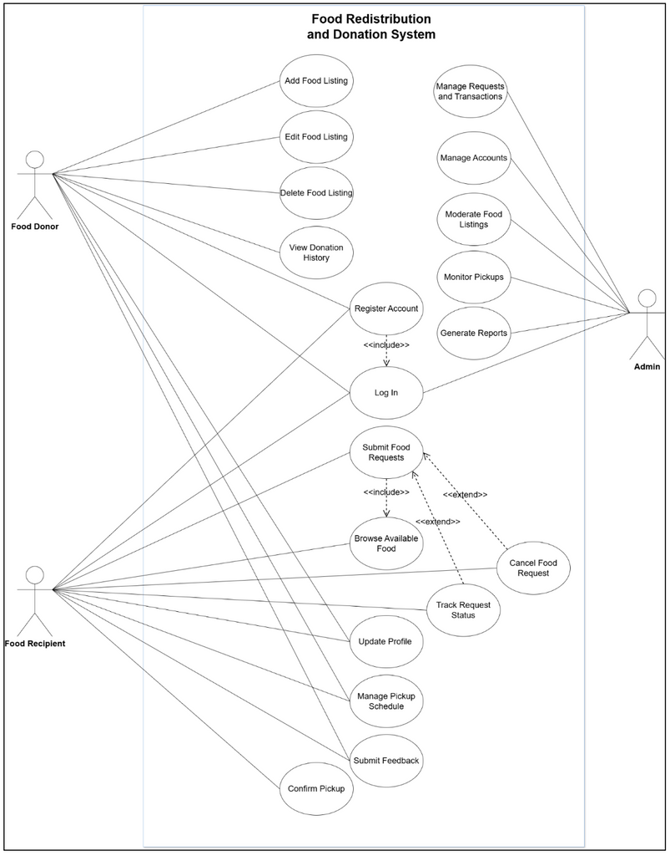
System Overview
Core User Roles & Interactions
Donor
Submit/edit food listings (Item, Quantity, Expiry, Location)
Receive pickup confirmations via Decorator Pattern (Email+SMS)
Recipient
Browse listings filtered by Strategy Pattern (Location/Expiry)
Track requests in real-time (Observer Pattern)
Admin
Monitor metrics via Singleton ReportManager
Moderate listings/requests
Technical Architecture
Frontend: Django Templates with Bootstrap
Backend Logic: MatchingService for smart scoring, NotificationDispatcher for real-time alerts
Database: SQLite via Django ORM
Key models: User, FoodListing, Request, Transaction

Slide 7

Software Architecture
Layered Architecture for Scalability & Maintainability
Presentation Layer:
Django templates with responsive Bootstrap-based UI
Business Logic Layer:
Core services like MatchingService and NotificationManager handle application logic and user interactions
Data Access Layer:
Django ORM for managing models and database queries
Database:
SQLite – lightweight, file-based storage suitable for rapid development and testing

Slide 8
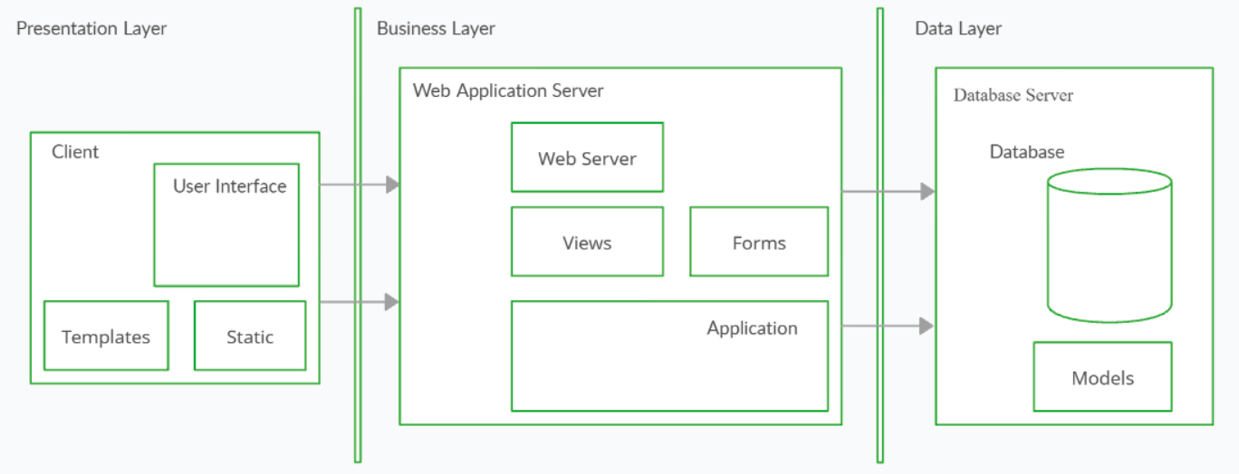
Architecture Diagram

Slide 9
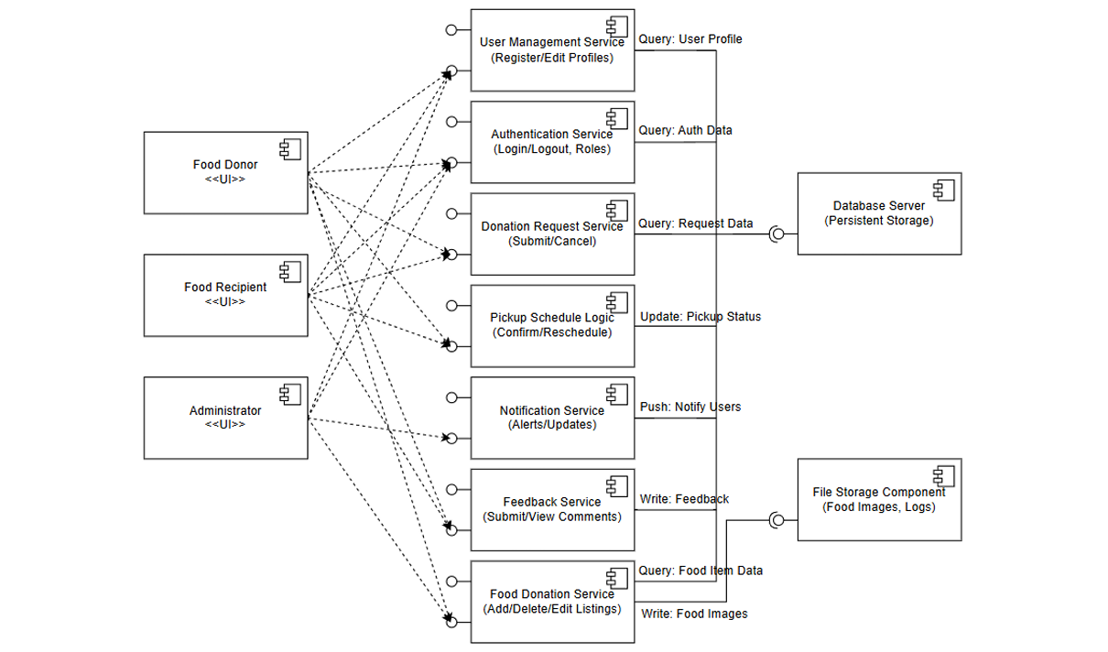
Component Diagram

Slide 10
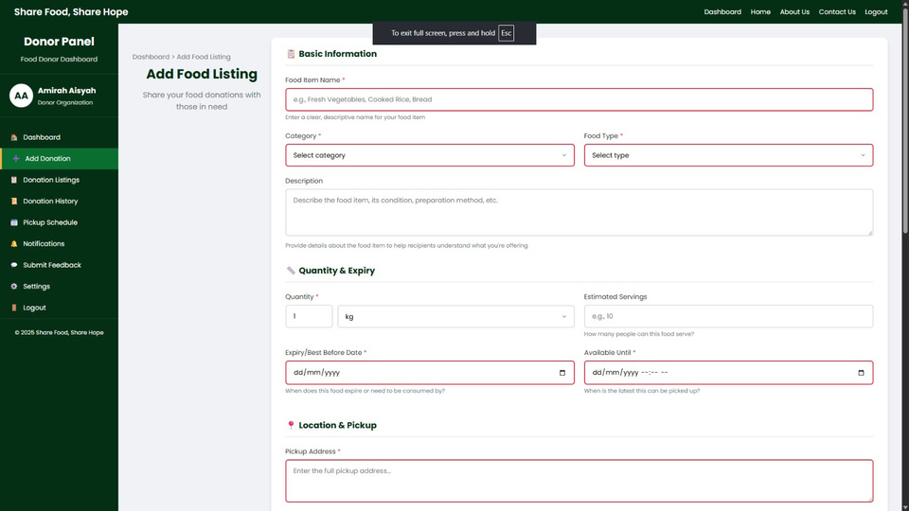
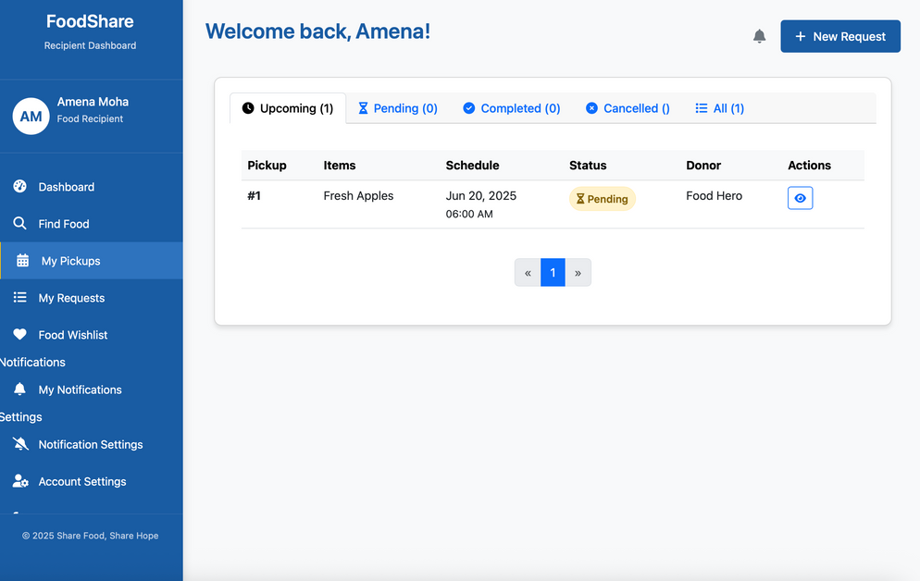
Input and Output
User Inputs
Donor:
{"foodType": "Rice", "quantity": 5, "expiry": "2025-06-30", "location": "Kuala Lumpur"}
Recipient:
{"requestedItems": [{"foodType": "Rice", "quantity": 2}]}
Admin:
Inputs via dashboard for approving users, moderating listings, and generating filtered reports.
System Outputs
Notifications:
{"channel": "SMS", "message": "Your rice donation has been matched and scheduled for pickup."}
Admin Reports (PDF/CSV):
Weekly fulfillment rates
Most requested food categories
Average matching time
Unfulfilled requests by location

Slide 11
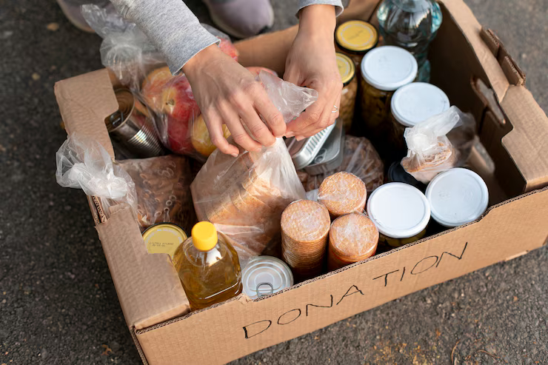
Solution achievment
Performance & Impact Metrics
Average response time remained below 2 seconds, meeting performance expectations (NFR1).
Simulated load tests confirmed stability with up to 1,000 concurrent users without degradation.
The matching engine achieved a 80% accuracy rate by combining location and expiry as dual criteria.
During pilot testing, the platform showed potential to reduce food waste by up to 60%, based on donation fulfillment trends.
Outcome Summary
The prototype successfully met all core objectives. It maintained stable performance under load, with real-time features like notifications and request tracking running smoothly.
Role-based modules for Donors, Recipients, and Admins were implemented with secure access and clear separation of responsibilities.
Core functionalities—such as matching, listing, and reporting—performed reliably in testing.
The system shows strong potential to contribute to sustainable food redistribution, supporting SDG 11 and SDG 12.

Slide 12

Work Segregation
Donor module (frontend & backend)
Recipient module (frontend & backend)
Recipient module (frontend & backend)
Admin module (frontend & backend)

Slide 13

This platform serves as a practical, scalable solution to food waste and insecurity in Malaysia, built using a clean architectural approach, modular services, and structured workflows.
Future Work
Mobile App & Location-Based Optimization
Cross-platform access with real-time coordination and geolocation-based pickup routing.
Smart Matching & Volunteer Management
AI-driven recommendation engine and integrated volunteer support for scalable operations.
Blockchain & Sector Integration
Transparent donation tracking with blockchain and API interoperability for NGOs and public systems.
conclusion

Slide 14
THANK
YOU

